Slide 1
Python: What’s in it for You
Douglas Starnes
Music City Tech
June 2018

Slide 2

Polyglot ninja
Memphis, TN area
Co-director of Mempy
Data Science/Machine Learning, Mobile Apps,
wannabe Game Designer
Pluralsight Author
Watch for carefully placed marketing through the talk!
@poweredbyaltnet
@poweredbyaltnet

Slide 3


I’m Python!
I’m not named after a snake!
I’m open source!
I’m cross-platform!
I’m simple!
I’m versatile!
I’m perfect for novices!
I’m also powerful enough for professionals!
@poweredbyaltnet

Slide 4


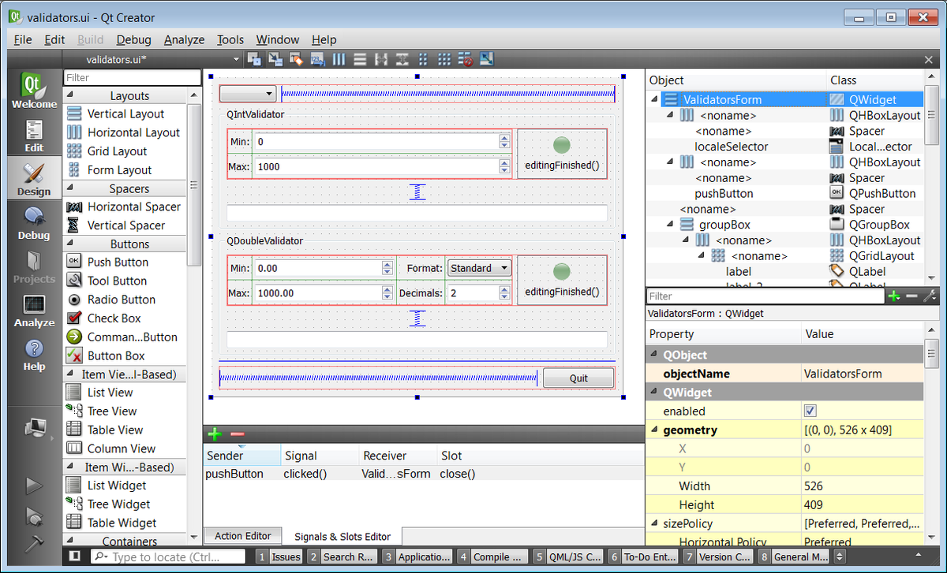
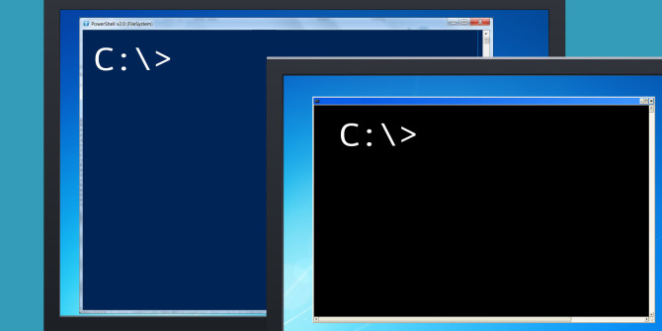

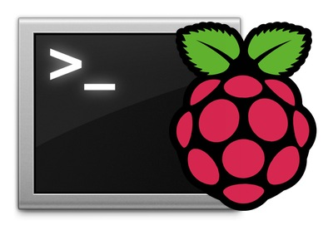

PYTHON
@poweredbyaltnet

Slide 5
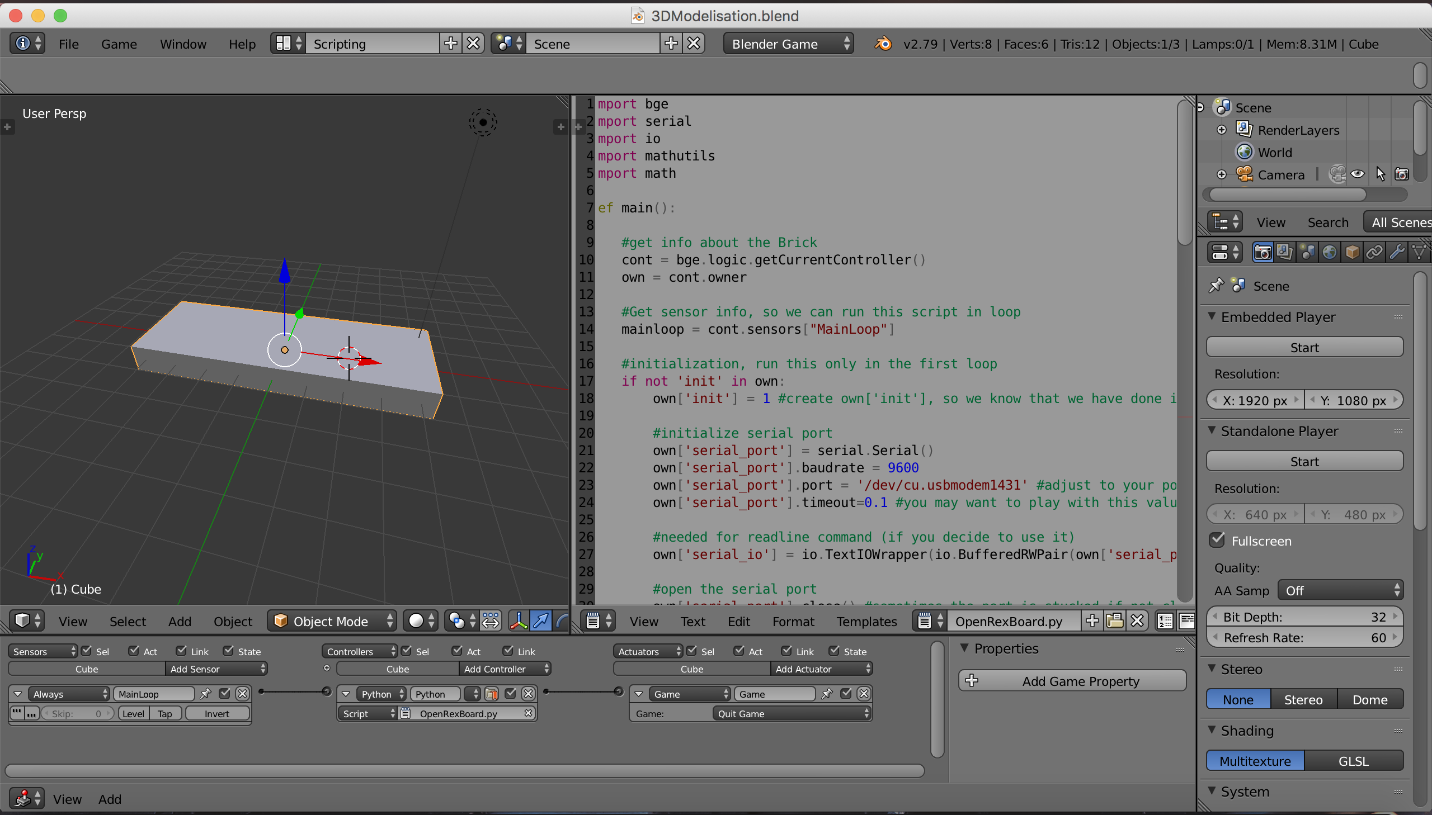
@poweredbyaltnet

Slide 6

@poweredbyaltnet

Slide 7

@poweredbyaltnet

Slide 8






@poweredbyaltnet

Slide 9

@poweredbyaltnet

Slide 10
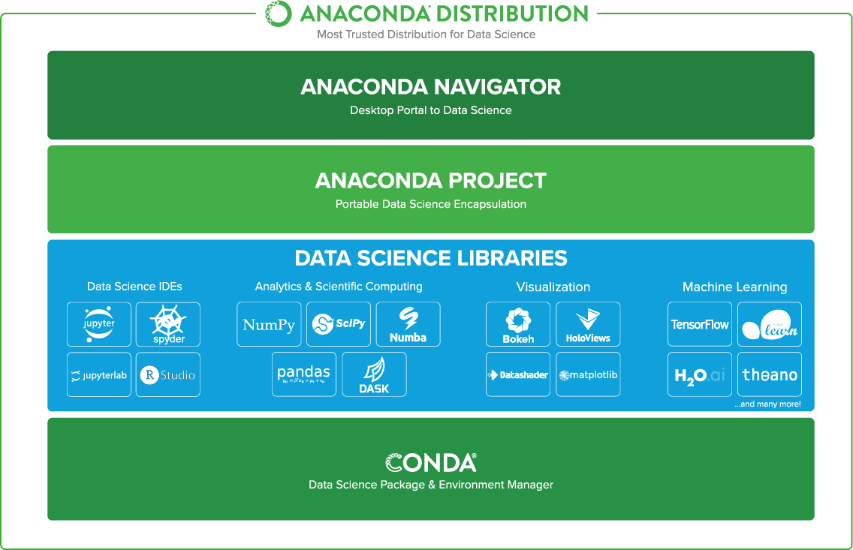
@poweredbyaltnet

Slide 11
haystack = 'she sells seashells down by the seashore'
Python is dynamically typed
counter = 0
Strings can be double or single quoted.
words = haystack.split(' ')
A Python list is a sequence of valid Python values,
similar to a JavaScript array.
for word in words:
for (int i = 0; i < length_of_words; i++) { … }
counter += 1
Iterate over the list.
my_list = [10, 3.14159, ‘a string’, [‘another’, ‘list’]]
Significant whitespace
denotes scope!
@poweredbyaltnet

Slide 12
PEP-8 is a ‘Python Enhancement Proposal’ which is a recommendation for coding style in Python
The recommendation for indentation is:
width 4
spaces (ie. not tabs)
Python is very strict about enforcing consistent indentation
Mixing spaces and tabs will cause trouble
Mixing widths will cause trouble
(I’ve seen some versions allow it, but it’s still better to use the same width)
And now back to your regularly scheduled demo, already in progress …
@poweredbyaltnet

Slide 13
haystack = 'she sells seashells down by the seashore'
counter = 0
words = haystack.split(' ')
print is a built-in function
for word in words:
counter += 1
print('There are {0} words in haystack.'.format(counter))
Modern format string using
positional placeholders
print('There are {0} words in haystack.'.format(len(words))
len is another built-in function
that returns the number of
values in the list or other object
s_words = 0
for venue in [‘Tech’, ‘Code’, ‘Data’, ‘Agile’]:
print(‘Music City %s’ % venue)
for word in words:
if word.startswith('s'):
s_words += 1
print("There are {0} 's' words in the haystack".format(s_words))
The syntax for if is similar to for
s_words = [word for word in words if word.startswith('s’)]
@poweredbyaltnet

Slide 14
some_words = [‘apples’, ‘bananas’, ‘carrots’, ‘eggplant’, ‘zucchini’]
cap_words = []
for word in some_words:
cap_word = word[0].upper() + word[1:]
cap_words.append(cap_word)
cap_words = [word[0].upper() + word[1:] for word in some_words]
cap_words
temporary list
some_words
Apples
A
A + pples
a
apples
B
B + ananas
Bananas
b
bananas
Carrots
C + arrots
carrots
Eggplant
E + ggplant
eggplant
Zucchini
Z + ucchini
zucchini
@poweredbyaltnet

Slide 15

haystack = 'she sells seashells down by the seashore'
counter = 0
words = haystack.split(' ')
I’ll take ‘swords’ for $400.
for word in words:
counter += 1
print('There are {0} words in haystack.'.format(counter))
print('There are {0} words in haystack.'.format(len(words))
s_words = 0
for word in words:
if word.startswith('s'):
s_words += 1
print("There are {0} 's' words in the haystack".format(s_words))
[1, 1, 1, 1]
s_words = [word for word in words if word.startswith('s’)]
Returns a list of 1’s
print("There are {0} 's' words in the haystack".format(len(s_words)))
s_words = [1 for word in words if word.startswith('s’)]
Add all of the 1’s
print("There are {0} 's' words in the haystack".format(sum(s_words)))
@poweredbyaltnet

Slide 16
server = ('http', 'musiccitytech.com', 80)
protocol, url, port = server
protocol, url, _ = server
servers = [
('https', 'musiccitytech.com', 443),
('http', 'test.musiccitytech.com', 8080),
('smtp', 'mail.musiccitytech.com', 25),
('http', 'musiccitytech.com', 80)]
def lookup_server(phase):
if phase == ‘secure’:
return servers[0]
elif phase == ‘test’:
return servers[1]
elif phase == ‘mail’:
return servers[2]
else:
return servers[3]
protocol, url, _ = lookup_server(‘test’)
@poweredbyaltnet

Slide 17
server = ('http', 'musiccitytech.com', 80)
protocol, url, port = server
A ‘tuple’ is similar to a list but
is fixed-length and immutable.
protocol, url, _ = server
servers = [
('https', 'musiccitytech.com', 443),
('http', 'test.musiccitytech.com', 8080),
('smtp', 'mail.musiccitytech.com', 25),
('http', 'musiccitytech.com', 80)]
Values in a tuple can be extracted and
assigned to variables simultaneously.
def lookup_server(phase):
if phase == ‘secure’:
return servers[0]
elif phase == ‘test’:
return servers[1]
elif phase == ‘mail’:
return servers[2]
else:
return servers[3]
The underscore is used for a ‘throwaway’ value.
A function begins with the def keyword,
the name of the function,
the parameter list in parentheses
and a colon.
Notice the use of elif as opposed to ‘else if’.
protocol, url, _ = lookup_server(‘test’)
Tuples are oft used to return
multiple values from a function.
@poweredbyaltnet

Slide 18
servers = {
‘secure’: ('https', 'musiccitytech.com', 443),
‘test’: ('http', 'test.musiccitytech.com', 8080),
‘mail’: ('smtp', 'mail.musiccitytech.com', 25),
‘plain’: ('http', 'musiccitytech.com', 80)}
A group of key/value pairs is a dictionary.
The key and value are separated by a colon.
no_value = None
def lookup_server(phase):
if phase in servers.keys():
return servers[phase]
raise Exception(‘Server does not exist’)
positive = True
negative = False
The dictionary keys are stored in a list-like object.
The pairs are separated by comma.
The in keyword checks for membership.
And the dictionary is surrounded by curly braces.
try:
mail = lookup_server(‘mail’)
print(‘{0}://{1}:{2}’.format(mail[0], mail[1], mail[2])
except Exception as e:
print(e)
In Python, we don’t throw exceptions,
we raise them.
We don’t catch exceptions, we except them.
try:
mail = servers[‘mail’]
print(‘{0}://{1}:{2}’.format(mail[0], mail[1], mail[2])
except KeyError as e:
print(e)
Python will raise a KeyError if a
missing key is requested
We access tuple values by position.
But this can be confusing.
from collections import namedtuple
Server = namedtuple(‘Server’, [‘protocol’, ‘url’, ‘port’])
mail = Server(‘smtp’, ‘mail.musiccitytech.com’, 25)
print(‘{0}://{1}:{2}’.format(mail.protocol, mail.url, mail.port)
The collections module in the
Python Standard Library provides
the namedtuple.
Which are accessed via dot syntax.
The namedtuple stores values in named fields.
@poweredbyaltnet

Slide 19
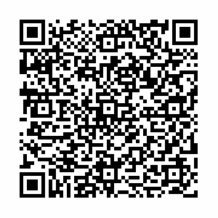

If you would like to know more about namedtuple and the Python Standard Library, please check out my Pluralsight course, ‘Getting Started with the Python Standard Library’.
Scan the code or visit the link for a FREE 10-day trial!
bit.ly/ps-python-standard-library
@poweredbyaltnet

Slide 20
A class begins with the class keyword,
the name of the class and the superclass
in parentheses.
class Server(object):
def __init__(self, protocol, url, port):
self._protocol = protocol
self._url = url
self._port = port
This method (pronounced ‘dunder init’)
is an initializer. It is not a constructor.
@poweredbyaltnet

Slide 21
struct Foo
__new__
m = malloc(sizeof(Foo))
Ox3B
myFoo = (Foo*)m
‘Hello world’
__init__
m->a = ‘Hello world’
m->b = 3.14159
3.14159
@poweredbyaltnet

Slide 22
The first value to a method is the
current instance of the class,
often referred to as ‘self’. It is similar
to ‘this’ in C# or Java.
class Server(object):
def __init__(self, protocol, url, port):
self._protocol = protocol
self._url = url
self._port = port
So called ‘dunder methods’ are provided
by Python and may be overridden in subclasses.
This method, ‘dunder stir’ returns,
the string representation of the object.
It is called by the print function.
def __str__(self):
return ‘{0}://{1}:{2}’.format(self._protocol, self._url, self._port)
def login(self, username, password):
raise NotImplementedError(‘this is not the method you are looking for’)
To create a new object, call
the initializer.
secure = Server(‘https’, ‘musiccitytech.com’, 443)
print(secure)
try:
secure.login(‘admin’, ‘supersecret’)
except NotImplementedError as e:
print(e)
Python implicitly passes the current instance
as the first argument to a method.
@poweredbyaltnet

Slide 23
class Server(object):
def __init__(self, protocol, url, port):
self._protocol = protocol
self._url = url
self._port = port
What if we forget to include ‘self’?
def __str__(self):
return ‘{0}://{1}:{2}’.format(self._protocol, self._url, self._port)
def login(username, password):
raise NotImplementedError(‘this is not the method you are looking for’)
secure = Server(‘https’, ‘musiccitytech.com’, 443)
print(secure)
try:
secure.login(‘admin’, ‘supersecret’)
except NotImplementedError as e:
print(e)
TypeError: login() takes 2 positional arguments but 3 were given
@poweredbyaltnet

Slide 24
class Server(object):
def __init__(self, protocol, url, port):
self._protocol = protocol
self._url = url
self._port = port
def __str__(self):
return ‘{0}://{1}:{2}’.format(self._protocol, self._url, self._port)
def login(self, username, password):
raise NotImplementedError(‘this is not the method you are looking for’)
secure = Server(‘https’, ‘musiccitytech.com’, 443)
print(secure)
try:
secure.login(‘admin’, ‘supersecret’)
except NotImplementedError as e:
print(e)
Declare a subclass of Server
class SMTPServer(Server):
The initializer has one less parameter.
def __init__(self, url, port):
if port == 25:
raise SecurityNoviceError(‘are you trying to enable the hackers and spammers?’)
super().__init__(‘smtp’, url, port)
def send(self, to, from, message):
raise NotImplmentedError(‘your message is lost’)
The protocol is hard-coded in the call to
the superclass initializer.
mail = SMTPServer(‘musiccitytech.com’, 26) # all of these statements will raise an error
mail.login(‘admin’, ‘supersecret’) # try block omitted for space
mail.send(‘them@example.com’, ‘me@example.com’, ‘Foo’) # and an excuse to show off comments
@poweredbyaltnet

Slide 25
What’s ‘missing’?
Some data types
(ie. no short unsigned int)
Constructs
for-next loop
switch statement
Operators
++ and --
Generics
Interfaces
this is done implicitly on the honor system (ie. iterables)
Single inheritance
Access modifiers
@poweredbyaltnet

Slide 26
class Server(object):
def __init__(self, protocol, url, port):
self._protocol = protocol
self._url = url
self._port = port
‘dunder’ methods are reserved for use
by Python … don’t create your own!
(even though you can)
def __str__(self):
return ‘{0}://{1}:{2}’.format(self._protocol, self._url, self._port)
def login(self, username, password):
raise NotImplementedError(‘this is not the method you are looking for’)
secure = Server(‘https’, ‘musiccitytech.com’, 443)
print(secure)
try:
secure.login(‘admin’, ‘supersecret’)
except Exception as e:
print(e)
properties and methods prefixed
with an underscore should be
treated as private
(even though you can access them)
class SMTPServer(Server):
def __init__(self, url, port):
if port == 25:
raise SecurityNoviceError(‘are you trying to enable the hackers and spammers?’)
super().__init__(‘smtp’, url, port)
def send(self, to, from, message):
raise NotImplmentedError(‘your message is lost’)
mail = SMTPServer(‘musiccitytech.com’, 26) # all of these statements will raise an error
mail.login(‘admin’, ‘supersecret’) # try block omitted for space
mail.send(‘them@example.com’, ‘me@example.com’, ‘Foo’) # and an excuse to show off comments
@poweredbyaltnet

Slide 27

@poweredbyaltnet

Slide 28
You can’t fix stupid
You can’t protect people from themselves
Don’t punish the responsible engineers
@poweredbyaltnet

Slide 29

TLDR: We’re all adults here.
Guido van Rossum – Python BDFL
(Benevolent Dictator For Life)
@poweredbyaltnet

Slide 30
The Zen of Python, by Tim Peters
Beautiful is better than ugly.
Explicit is better than implicit.
Simple is better than complex.
Complex is better than complicated.
Flat is better than nested.
Sparse is better than dense.
Readability counts.
Special cases aren't special enough to break the rules.
Although practicality beats purity.
Errors should never pass silently.
Unless explicitly silenced.
In the face of ambiguity, refuse the temptation to guess.
There should be one-- and preferably only one --obvious way to do it.
Although that way may not be obvious at first unless you're Dutch.
Now is better than never.
Although never is often better than *right* now.
If the implementation is hard to explain, it's a bad idea.
If the implementation is easy to explain, it may be a good idea.
Namespaces are one honking great idea -- let's do more of those!
@poweredbyaltnet

Slide 31
The Zen of Python, by Tim Peters
Beautiful is better than ugly.
Explicit is better than implicit.
Simple is better than complex.
Complex is better than complicated.
Flat is better than nested.
Sparse is better than dense.
Readability counts.
Special cases aren't special enough to break the rules.
Although practicality beats purity.
Errors should never pass silently.
Unless explicitly silenced.
In the face of ambiguity, refuse the temptation to guess.
There should be one-- and preferably only one --obvious way to do it.
Although that way may not be obvious at first unless you're Dutch.
Now is better than never.
Although never is often better than *right* now.
If the implementation is hard to explain, it's a bad idea.
If the implementation is easy to explain, it may be a good idea.
Namespaces are one honking great idea -- let's do more of those!
i++
i += 1
@poweredbyaltnet

Slide 32
The Zen of Python, by Tim Peters
Beautiful is better than ugly.
Explicit is better than implicit.
Simple is better than complex.
Complex is better than complicated.
Flat is better than nested.
Sparse is better than dense.
Readability counts.
Special cases aren't special enough to break the rules.
Although practicality beats purity.
Errors should never pass silently.
Unless explicitly silenced.
In the face of ambiguity, refuse the temptation to guess.
There should be one-- and preferably only one --obvious way to do it.
Although that way may not be obvious at first unless you're Dutch.
Now is better than never.
Although never is often better than *right* now.
If the implementation is hard to explain, it's a bad idea.
If the implementation is easy to explain, it may be a good idea.
Namespaces are one honking great idea -- let's do more of those!
for word in words:
if word.startswith('s'):
s_words += 1
[word for word in word if word.startswith(‘s’)]
@poweredbyaltnet

Slide 33
The Zen of Python, by Tim Peters
Beautiful is better than ugly.
Explicit is better than implicit.
Simple is better than complex.
Complex is better than complicated.
Flat is better than nested.
Sparse is better than dense.
Readability counts.
Special cases aren't special enough to break the rules.
Although practicality beats purity.
Errors should never pass silently.
Unless explicitly silenced.
In the face of ambiguity, refuse the temptation to guess.
There should be one-- and preferably only one --obvious way to do it.
Although that way may not be obvious at first unless you're Dutch.
Now is better than never.
Although never is often better than *right* now.
If the implementation is hard to explain, it's a bad idea.
If the implementation is easy to explain, it may be a good idea.
Namespaces are one honking great idea -- let's do more of those!
class Server():
pass
class Server(object):
pass
@poweredbyaltnet

Slide 34


Slide 35
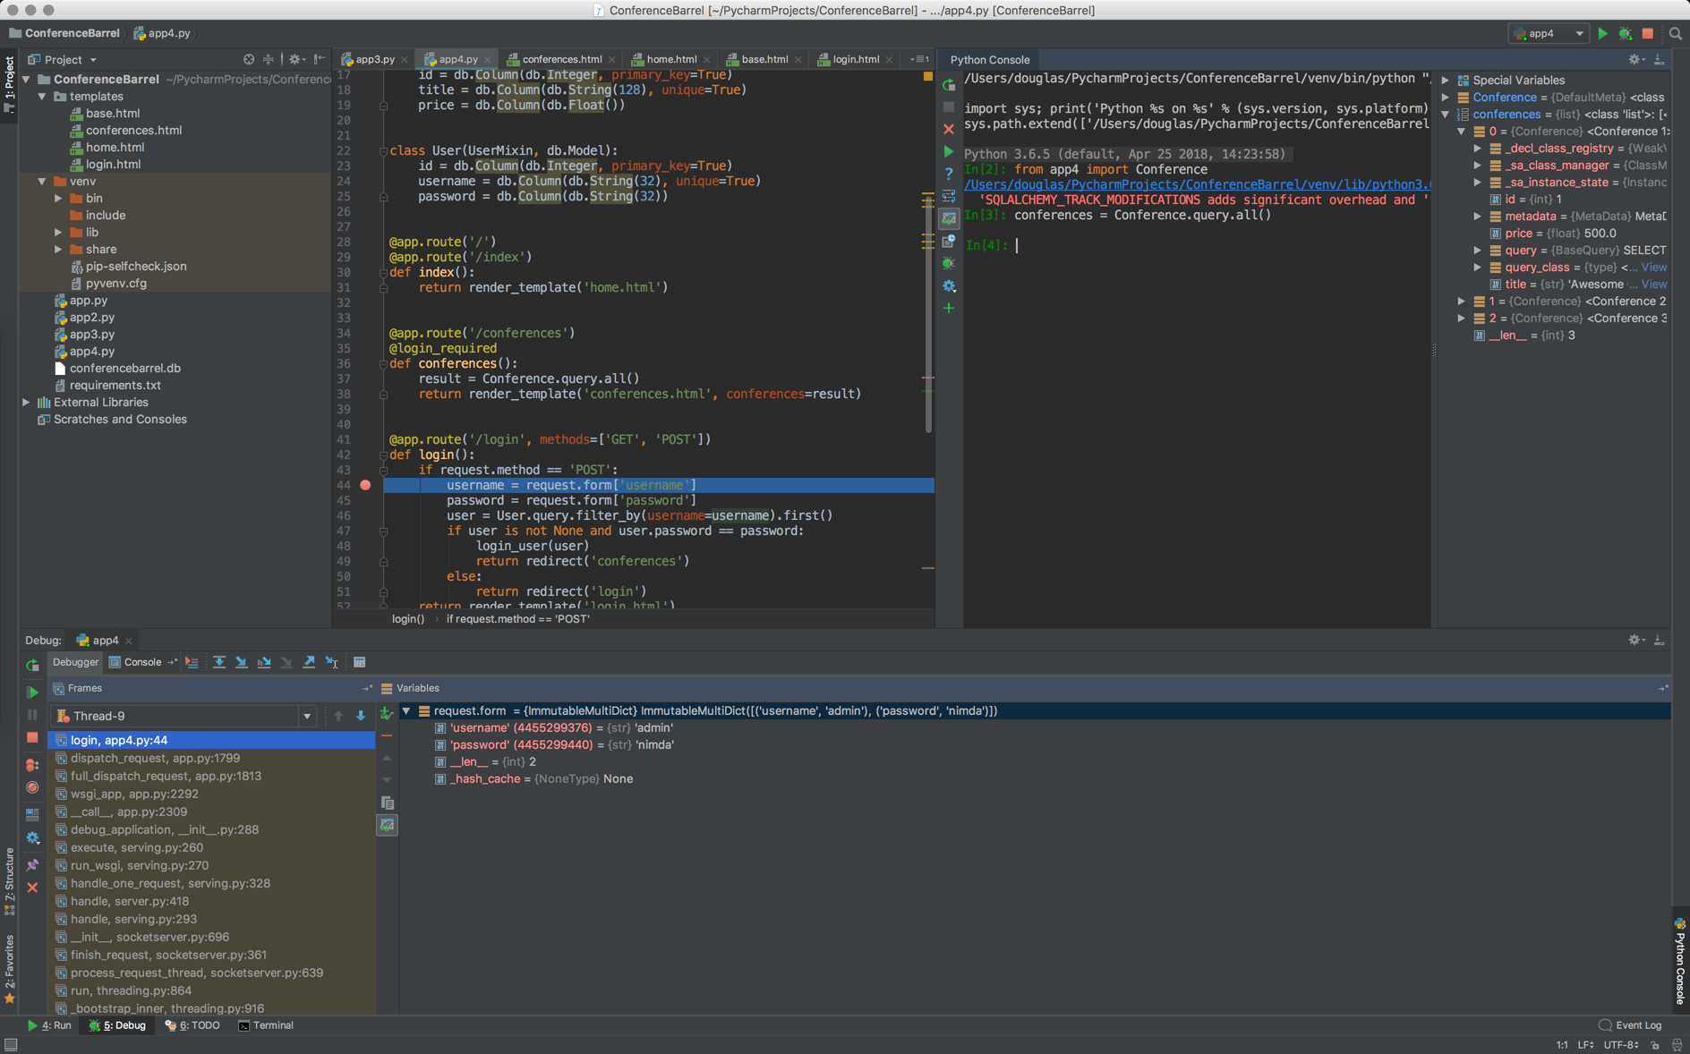

Slide 36
DEMO
Web application using Flask
@poweredbyaltnet

Slide 37
DEMO
Data science using PyData
@poweredbyaltnet

Slide 38
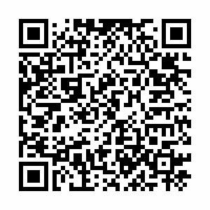
If you would like to know more about Jupyter Notebook, please check out my Pluralsight course, ‘Getting Started with Jupyter Notebook and Python’.
Scan the code or visit the link for a FREE 10-day trial!
http://bit.ly/jupyter-notebook
@poweredbyaltnet

Slide 39
Thank you!
douglas@douglasstarnes.com
@poweredbyaltnet
www.douglasstarnes.com
Slides: github.com/douglasstarnes/MusicCityTech18

